Slide 1



POSITIONAL ENCODING
IN TRANSFORMER ARCHITECTURE
WHY POSITIONAL ENCODING
HOW POSITIONAL ENCODING WORKS
TYPES OF POSITIONAL ENCODING
ATANDA ABDULLAHI ADEWALE

Slide 2
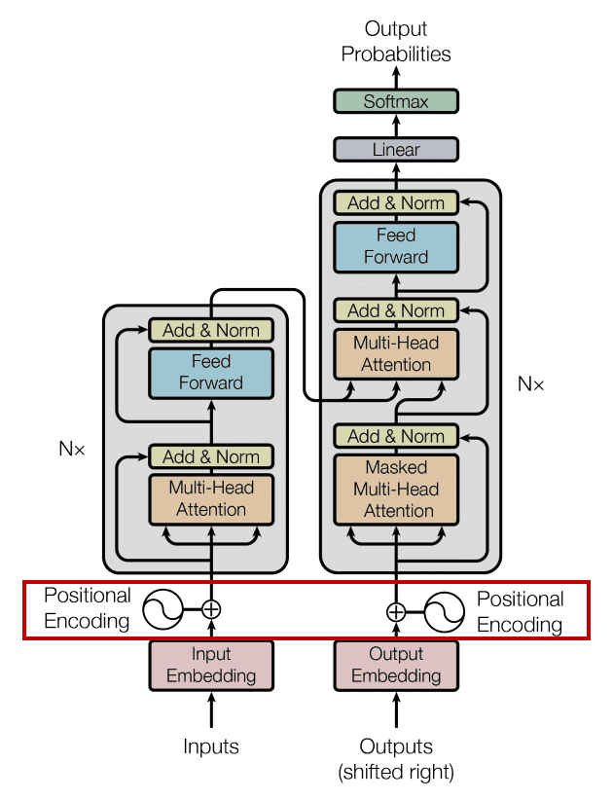
Problem
ATTENTION DOESN’T CARE ABOUT THE POSITION OF THE INPUTS
self-attention layer is permutation invariant
Positional encoding describes the location or position of an entity in a sequence so that each position is assigned a unique representation
FIX
Transformers use a smart positional encoding scheme, each position/index is mapped to a vector.
The output is a matrix, each row represents an encoded object of the sequence summed with its positional information.
Notes:
self-attention layer is permutation invariant (that is, the output values do not change if you change the order (position) of words in a sentence).
Large seq, If you normalize the index value to lie between 0 and 1, it can create problems for variable length sequences as they would be normalized differently.

Slide 3
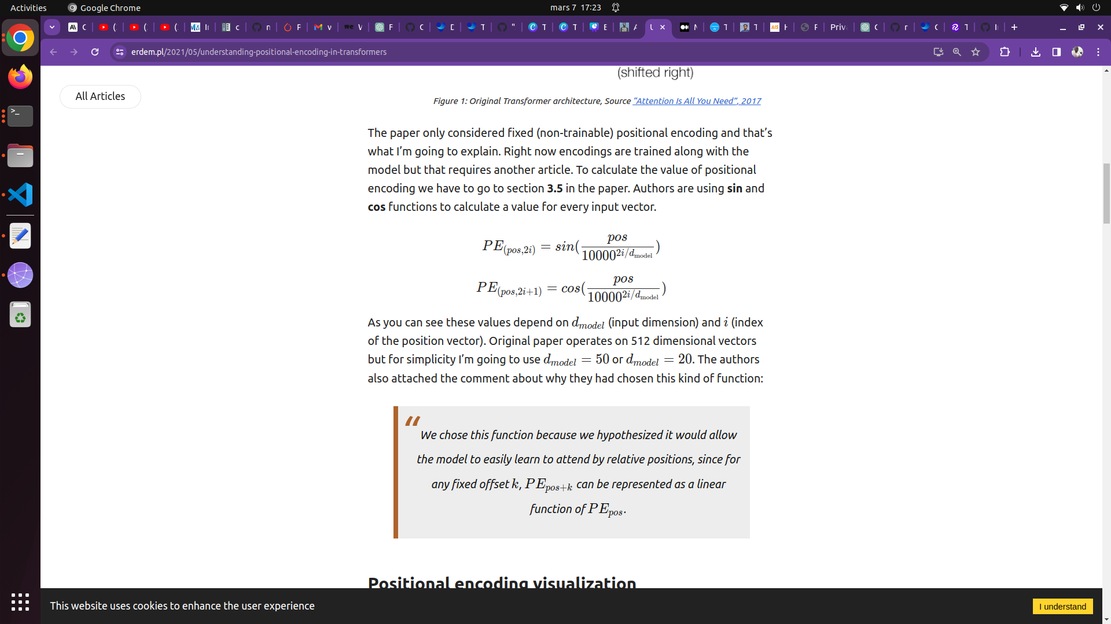
How ?
SECTION 3.5 IN THE PAPER, AUTHORS USE SIN AND COS FUNCTIONS TO CALCULATE A VALUE FOR EVERY INPUT VECTOR.
Notes:
If you normalize the index value to lie between 0 and 1, it can create problems for variable length sequences as they would be normalized differently.

Slide 4
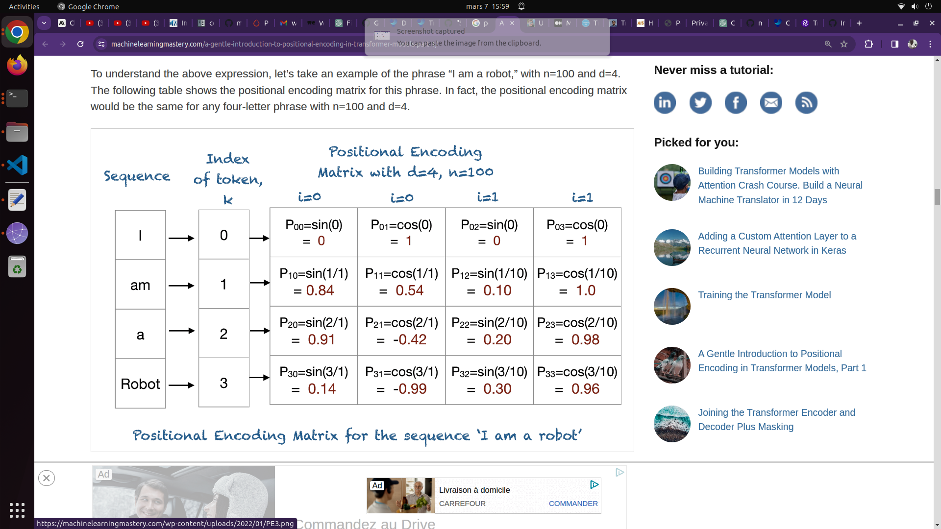
How ?
SECTION 3.5 IN THE PAPER, AUTHORS USE SIN AND COS FUNCTIONS TO CALCULATE A VALUE FOR EVERY INPUT VECTOR.
d (input dimension)
i (index of the position vector).
pos - position of the vector
Original paper operates on 512 dimensional vectors
model
Notes:
n : User-defined scalar, set to 10,000 by the authors of Attention Is All You Need.
K: Position of an object in the input sequence 0<k<l/2
i: Used for mapping to column indices
0<i<d/2
with a single value of
maps to both sine and cosine functions

Slide 5

How ?
SECTION 3.5 IN THE PAPER, AUTHORS USE SIN AND COS FUNCTIONS TO CALCULATE A VALUE FOR EVERY INPUT VECTOR.
d (input dimension)
i (index of the position vector).
pos - position of the vector
Original paper operates on 512 dimensional vectors
model
Notes:
The value of each positional encoding depends on the position (pos) and dimension (d). We calculate result for every index (i) to get the whole vector.

Slide 6
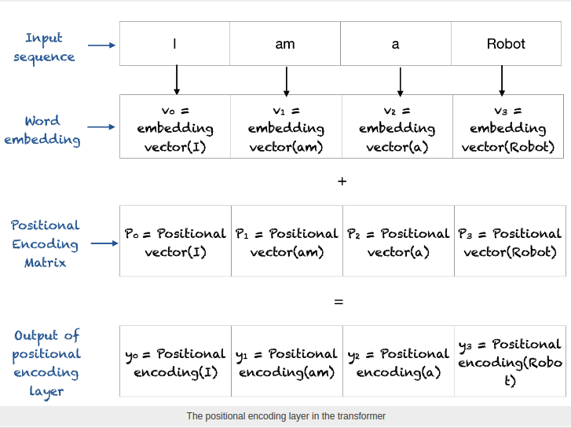
How ?
SECTION 3.5 IN THE PAPER, AUTHORS USE SIN AND COS FUNCTIONS TO CALCULATE A VALUE FOR EVERY INPUT VECTOR.
d (input dimension)
i (index of the position vector).
pos - position of the vector
Original paper operates on 512 dimensional vectors
model

Slide 7
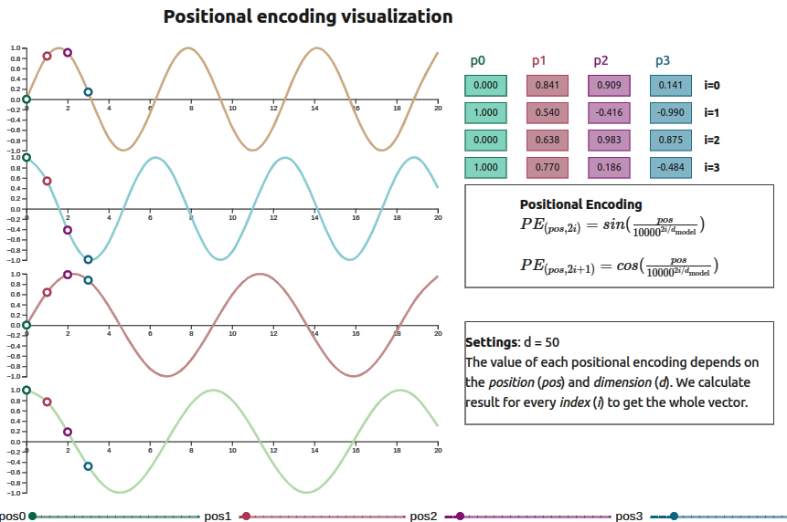

Slide 8
Other types of Positional Encoding
Absolute Positional Embeddings
Relative Positional Embeddings
Learned positional embeddings.
just like input embeddings, it uses a positional embedding table with all the possible token positions that the model supports
Only encodes the relative pairwise distance between two tokens.
positional information is embedded directly in the Query (Q) and Key (K) vectors used for scaled dot-product attention. No positional embeddings are added to the token embeddings!
it is bounded to a maximum input size
BERT
GPT-2
Two most widely used types :
RoPE (Rotary Positional Embeddings)
ALiBi (Attention with Linear Biases)

Slide 9

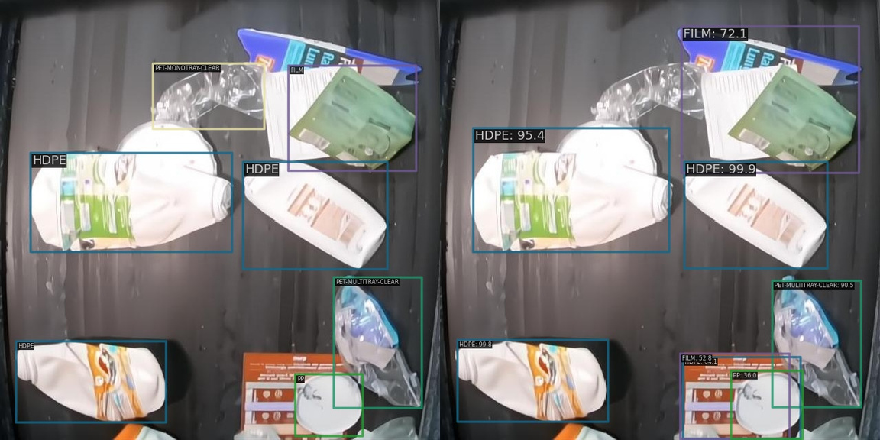
CUSTOM WASORIA SAMPLE DATASET
YoloV8 (Official) vs ResNet (MMDET)
Anchor-based, single-stage object detection system celebrated for its real-time processing speed and accuracy, simplifying deployment across various devices.
Versatile backbone architecture that can be adapted to both anchor-based and two-stage detection systems, captures multi-scale features through a hierarchical residual-like connection within blocks

Slide 10
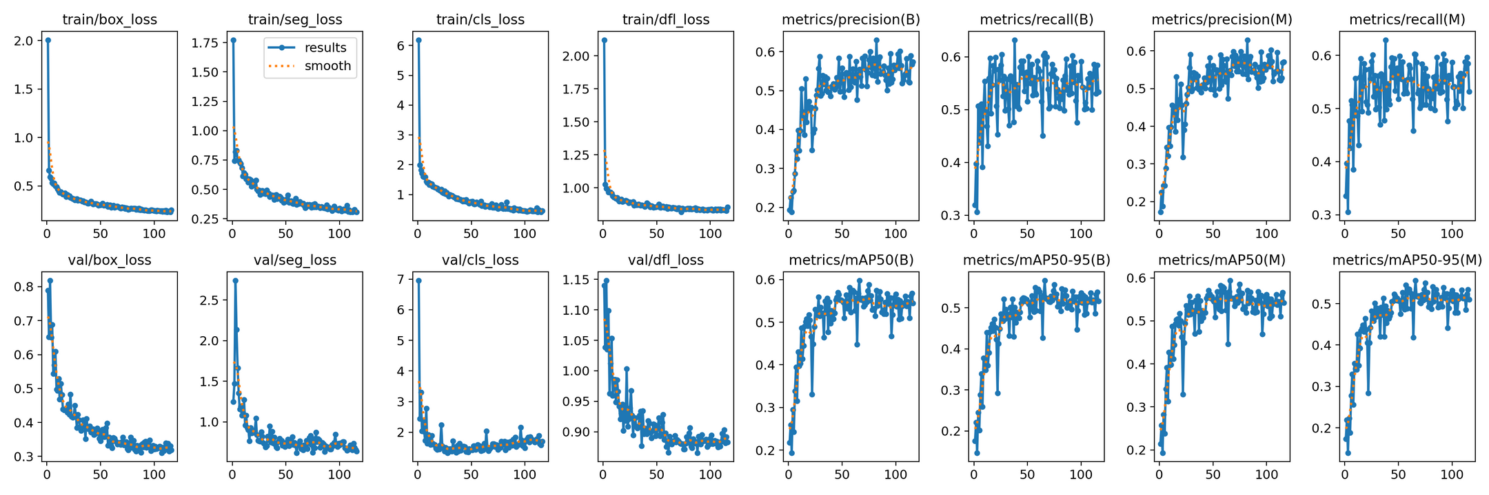
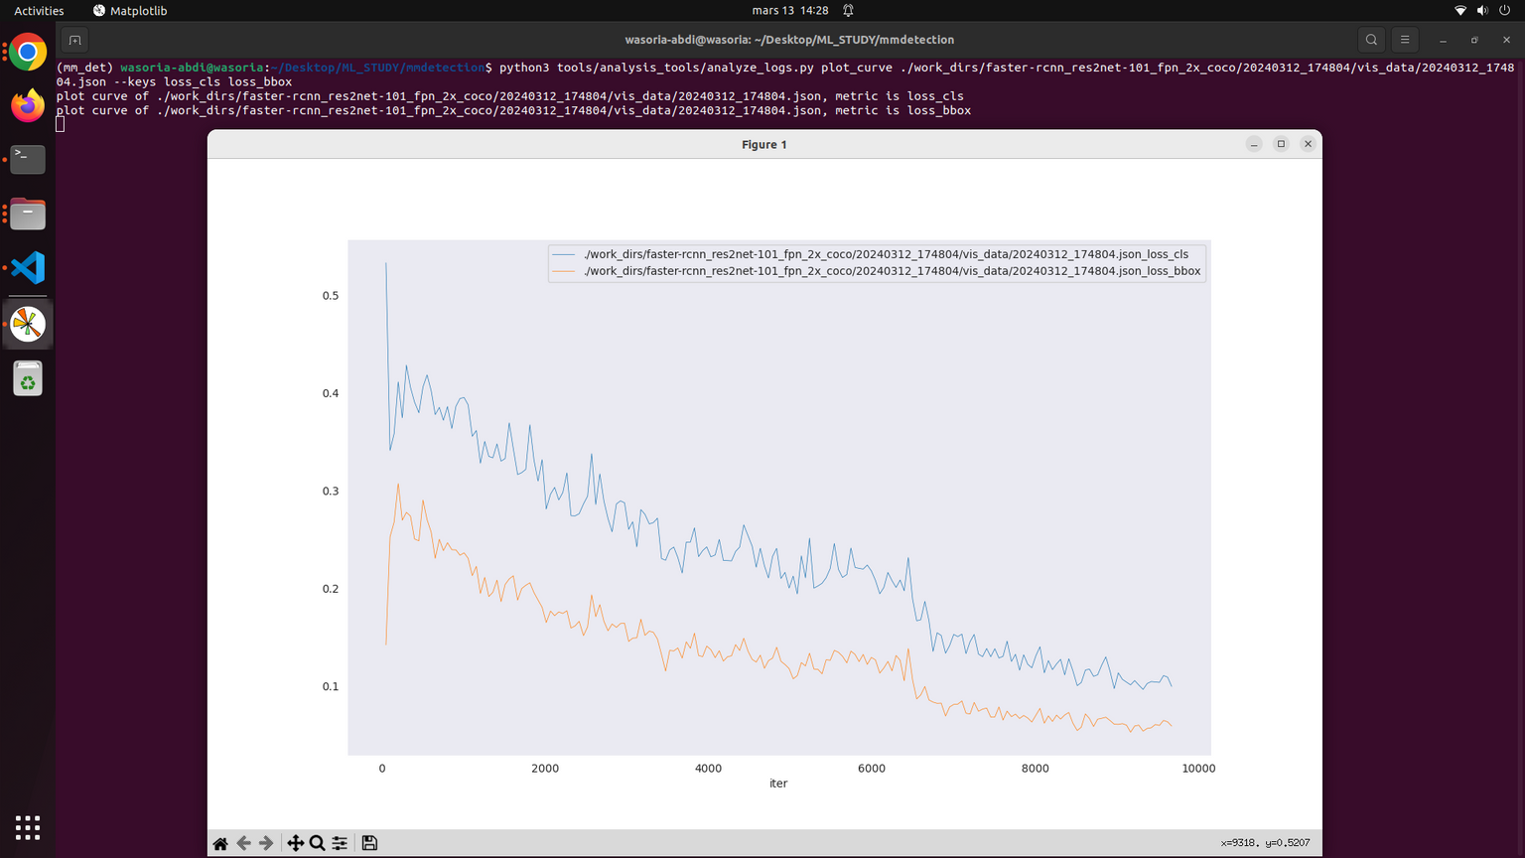
CUSTOM WASORIA SAMPLE DATASET
YoloV8 (Official) vs ResNet (MMDET)
Anchor-based, single-stage object detection system celebrated for its real-time processing speed and accuracy, simplifying deployment across various devices.
Versatile backbone architecture that can be adapted to both anchor-based and two-stage detection systems, captures multi-scale features through a hierarchical residual-like connection within blocks
coco/bbox_mAP": 0.519, "coco/bbox_mAP_50": 0.61,
"coco/bbox_mAP_75": 0.572, "coco/bbox_mAP_s": -1.0,
"coco/bbox_mAP_m": 0.284, "coco/bbox_mAP_l": 0.517,
"data_time": 0.05058869836632341, "time": 0.11036690249713747}
coco/bbox_mAP": 0.519, "coco/bbox_mAP_50": 0.61,
"coco/bbox_mAP_75": 0.572, "coco/bbox_mAP_s": -1.0,
"coco/bbox_mAP_m": 0.284, "coco/bbox_mAP_l": 0.517,
"data_time": 0.05058869836632341, "time": 0.11036690249713747}

Slide 11
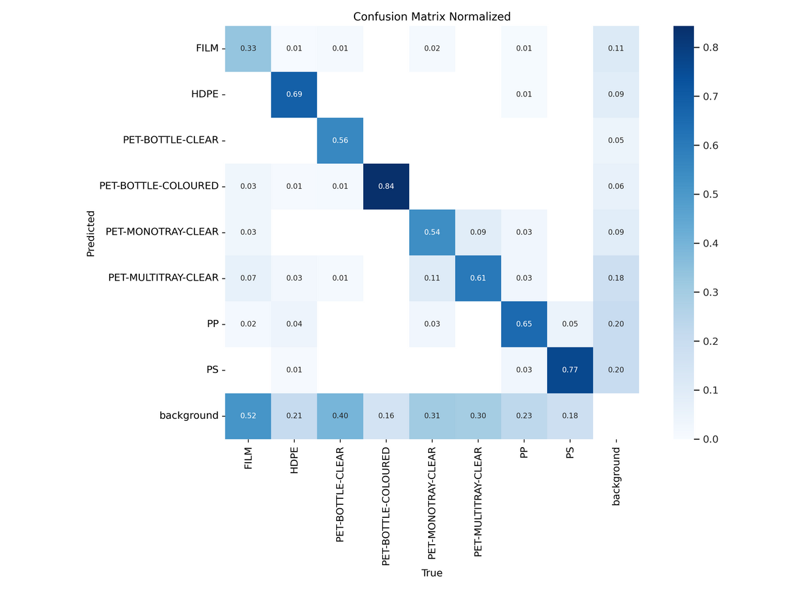
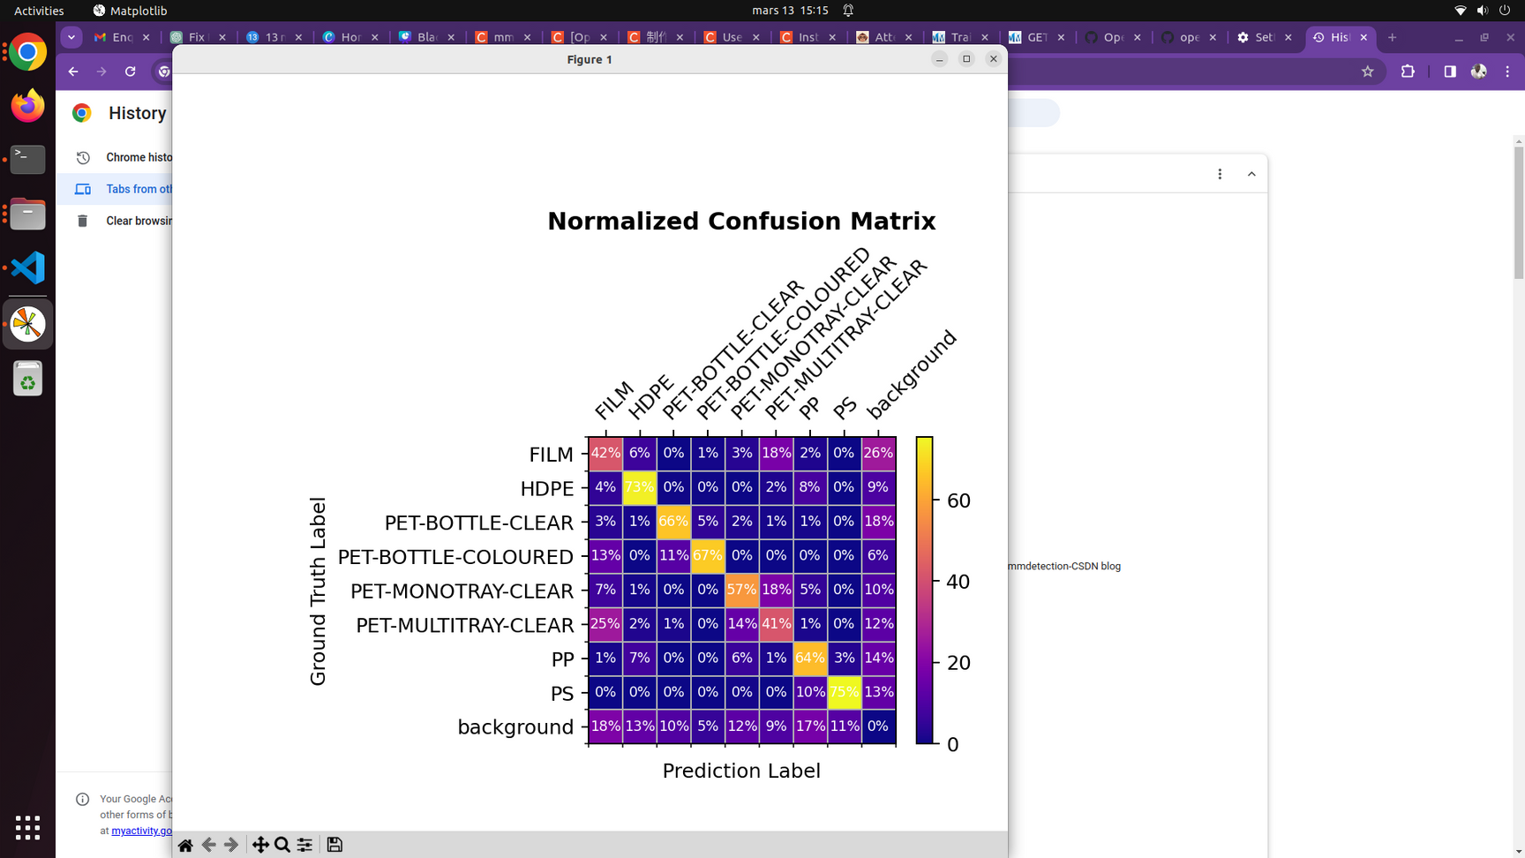
CUSTOM WASORIA SAMPLE DATASET
YoloV8 (Official) vs ResNet (MMDET)
Anchor-based, single-stage object detection system celebrated for its real-time processing speed and accuracy, simplifying deployment across various devices.
Versatile backbone architecture that can be adapted to both anchor-based and two-stage detection systems, captures multi-scale features through a hierarchical residual-like connection within blocks

Slide 12
References:
Transformers Positional Encodings Explained, João Lages
https://pub.towardsai.net/the-quest-to-have-endless-conversations-with-llama-and-chatgpt-%EF%B8%8F-81360b9b34b2
1
A Gentle Introduction to Positional Encoding in Transformer Models, Part 1
https://machinelearningmastery.com/a-gentle-introduction-to-positional-encoding-in-transformer-models-part-1/
2
Transformer Architecture: The Positional Encoding, Amirhossein Kazemnejad
https://kazemnejad.com/blog/transformer_architecture_positional_encoding/
3
Understanding Positional Encoding in Transformers, Kemal Erdem
https://erdem.pl/2021/05/understanding-positional-encoding-in-transformers
4
How the Vision Transformer (ViT) works in 10 minutes, Nikolas Adaloglou
https://theaisummer.com/vision-transformer/
5

Slide 13
Thank you for listening!
ATANDA ABDULLAHI ADEWALE

